Slide 1

KAMLA NEHRU INSTITUTE OF TECHNOLOGY , SULTANPUR
Department of Mechanical Engineering
Plant watering system
Submitted by ;
Mr Kartikay Agarwal (23538}
Under the supervision of
Mr Varun Sonkar

Slide 2
OUTLINE
Introduction
Objective
Materials Required
Experimental Procedures
Expected outcomes
Advantages
Disadvantages
Refernces

Slide 3
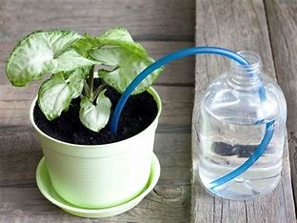
INTRODUCTION
Plants require consistent and adequate watering to thrive, but many people struggle to provide the right amount of care due to time constraints or lack of experience. Traditional manual watering can lead to problems such as overwatering or underwatering, both of which can harm plant health. To address this challenge, automated plant watering systems have gained popularity, especially for busy individuals or those with multiple plants.
This project focuses on developing a simple yet effective automated plant watering system using an Arduino Uno, a soil moisture sensor, a water pump, and a relay module.

Slide 4
OBJECTIVE
Automate Plant Care: To create a system that automatically waters plants by detecting the moisture levels of the soil, ensuring the plant receives water only when needed. This reduces the need for manual watering.
Prevent Overwatering and Underwatering: By using a soil moisture sensor, the system ensures that plants are watered when the soil is too dry, but not excessively. This helps to avoid the issues of overwatering (which can cause root rot) and underwatering (which can lead to dehydration and plant stress).
Enhance Water Conservation: The system helps conserve water by ensuring that water is only used when the moisture level in the soil is below a set threshold. This reduces water waste and promotes sustainable plant care.
Provide Consistency and Reliability: To develop a system that provides consistent, reliable watering regardless of the user’s schedule or availability. This is particularly useful for busy individuals or for people who travel frequently.
Simple and Cost-Effective Solution: To build a system that is simple to assemble, cost-effective, and easy to use, utilizing common components such as an Arduino Uno, soil moisture sensor, water pump, and relay module.

Slide 5
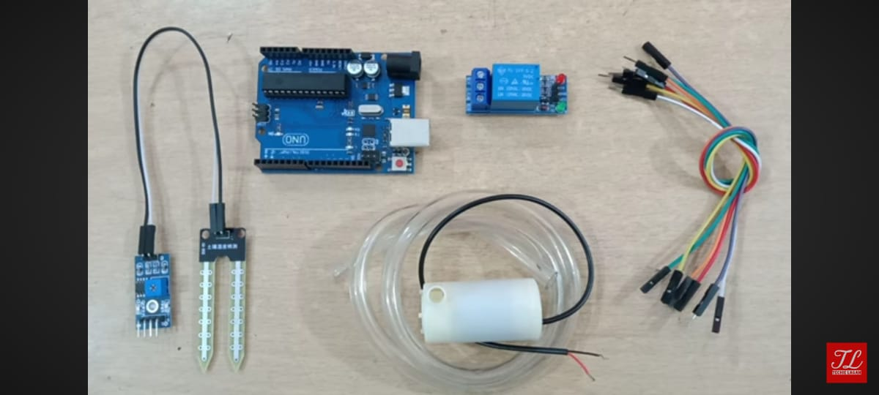
MATERIALS REQUIRED
Arduino Uno
Soil Moisture Sensor (analog type)
Water Pump (12V or suitable for your system)
Relay Module (5V, to control the water pump)
Water Reservoir (to hold the water)
Tubing (to deliver water from the pump to the plant)
Jumper Wires (for connections)
Power Supply (for the Arduino and the water pump)
Plant Pot with Soil (to test the system)
Breadboard (optional, for easier connections)

Slide 6
Experimental Procedures
Step 1: Preparing the Hardware Setup
Connect the Soil Moisture Sensor:
Connect the VCC pin of the soil moisture sensor to the 5V pin on the Arduino.
Connect the GND pin of the sensor to GND on the Arduino.
Connect the Analog Output (A0) pin of the soil moisture sensor to A0 on the Arduino to read the sensor data.
Wire the Relay Module:
Connect the VCC pin of the relay to 5V on the Arduino.
Connect the GND pin of the relay to GND on the Arduino.
Connect the IN pin of the relay to a digital pin (D7) on the Arduino, which will be used to control the relay.
Connect the Water Pump:
Connect the VCC pin of the water pump to an external power source (12V) or the appropriate voltage required by your pump.
Connect the GND pin of the water pump to GND on the Arduino (through the relay).
Connect the control wire of the pump to the NO (Normally Open) terminal of the relay.
Prepare the Water Reservoir:
Place the water pump inside the water reservoir and ensure the tubing is securely connected from the pump's outlet to the plant pot.

Slide 7
Step 2: Software Setup and Code Upload
Arduino IDE Installation:
Ensure that the Arduino IDE is installed on your computer. If not, download it from the official Arduino website.
Code Upload:
Open the Arduino IDE and write or copy the code to control the soil moisture sensor and the water pump. A sample code is shown below:
Step 3: Calibration of Soil Moisture Sensor
Test the Moisture Sensor:
Insert the soil moisture sensor into the soil in the plant pot.
Open the Serial Monitor in the Arduino IDE to view the readings from the moisture sensor.
The sensor will give a value between 0 and 1023. The value closer to 0 indicates very dry soil, while values closer to 1023 indicate very wet soil.
Set Moisture Threshold:
Based on the Serial Monitor readings, calibrate the moisture threshold value in the code.
For example, if the soil is wet, the sensor might give a value around 800, and if the soil is dry, it might give a value around 300.
Set the threshold value in the code (e.g., moistureThreshold = 500) to decide when the water pump should activate.

Slide 8
Step 4: Testing the System
Initial Test:
With the soil moisture sensor placed in the soil, ensure the water pump is powered by the external 12V supply.
Open the Serial Monitor in the Arduino IDE to observe the moisture level readings.
Check if the water pump turns ON when the soil moisture level falls below the threshold (dry soil) and turns OFF when the soil reaches adequate moisture levels.
Simulate Dry and Wet Soil Conditions:
Manually adjust the moisture level of the soil:
To test dry soil, remove moisture from the soil (e.g., allow the soil to dry or pour a small amount of water out).
To test wet soil, add water to the plant and observe the changes in the sensor readings.
Ensure the pump operates correctly: turning on when dry and turning off when wet.
Adjust Code or Hardware:
If the pump doesn’t turn on/off as expected, recheck the wiring and ensure the code logic is correct.
Fine-tune the moistureThreshold in the code if needed to suit your plant’s requirements.
Step 5: Final Validation
Longer Testing:
Allow the system to run for several hours or days, ensuring that the pump turns on and off automatically based on the soil moisture level.
Check if the system consistently waters the plant without overwatering or underwatering it.
Fine-Tuning:
If necessary, adjust the moisture threshold for more accurate watering or test different delay times in the code to control how often the moisture level is checked.

Slide 9
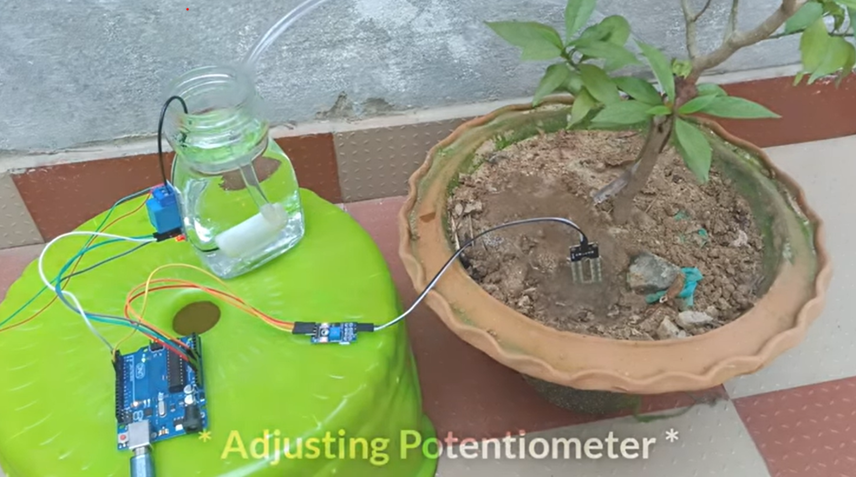
Conclusion:
Following this experimental procedure ensures that the automated plant watering system is properly set up, tested, and calibrated. By carefully monitoring the sensor readings and pump operations, the system can be fine-tuned to provide optimal care for the plant with minimal manual intervention.

Slide 10
ADVANTAGES DISADVANTAGES
Automatic Watering
Water Conservation
Customization
Cost-Effective
Prevention of Plant Stress
Remote Monitoring (Optional)
System Failures
Limited Water Supply
Complexity
Power Dependency
Water Distribution Issues
Maintenance
Limited Plant Compatibility

Slide 11
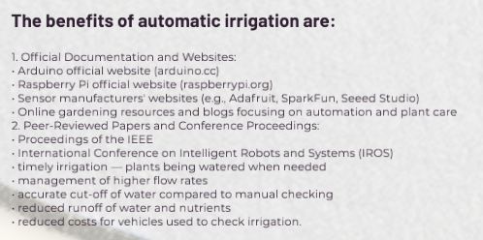
REFERENCES

